Slide 1
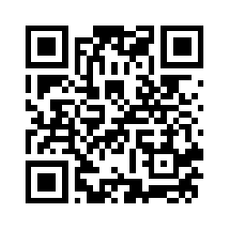
Welcome, to the 2023 Region VII Benefits Cooperative Meeting
Hosted By:
Scan QR Code Above to Register

Slide 2
2023 Region 7 Benefits Co-op Meeting Agenda
Welcome – Donnie Gentry
School Health Insurance Update / Legislative Update – Todd Schneider, Director Region 7 ESC
Financial Literacy –Tony Betancourt & Tyler Daniels
Product Updates – Matt Jones
Break!
Enrollment Strategy 2023 – Clint Thurman
Guardian Products – Kaley Doherty
Medicare Consulting – Carolyn Rimbey
Athletic Insurance – Donnie Gentry
It’s a numbers game.-Chad Gentry

Slide 3
School Health Insurance and Legislative Update
Todd Schneider
-Executive Director Region 7 ESC

Slide 4
2023 Sponsors

Slide 6
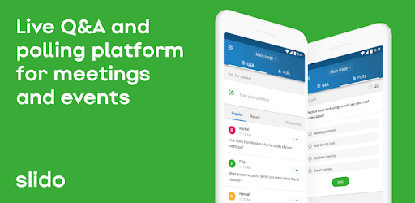
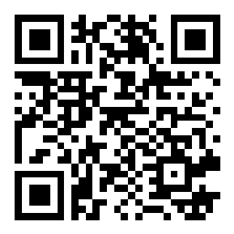
1. Download the Slido app
2. Enter code 1458964

Slide 7
Current GFG School Groups
Forney ISD
Gilmer ISD
Grand Saline ISD
Harleton ISD
Harmony ISD
Hawkins ISD
Henderson ISD
Kaufman ISD
Kerens ISD
Lapoynor ISD
Leonard ISD
Leverett’s Chapel ISD
Lindale ISD
Lone Oak ISD
Mabank ISD
Malakoff ISD
Marshall ISD
Martins Mill ISD
Melissa ISD
Alba Golden ISD
Alto ISD
Anderson County Coop
Arp ISD
Athens ISD
Big Sandy ISD
Blanco ISD
Bland ISD
Boles ISD
Brownsboro ISD
Bullard ISD
Canton ISD
Carlisle ISD
Cayuga ISD
Colmesneil ISD
Community ISD
Cross Roads ISD
Cumberland Academy
Daingerfield ISD
East Texas Charter
Edgewood ISD
Elysian Fields ISD
Farmersville ISD
Mildred ISD
Mineola ISD
Murchison ISD
New Diana ISD
Olney ISD
Ore City ISD
Quinlan ISD
Quitman ISD
Rains ISD
Sabine ISD
Slocum ISD
Spring Hill ISD
Spurger ISD
Terrell ISD
Trenton ISD
Union Grove ISD
Union Hill ISD
Van ISD
Waskom ISD
West Rusk ISD
Wolfe City ISD
Yantis ISD

Slide 8
- Exercise
- Dieting
What is something unpleasant that must be accepted in order to achieve a particular result?
- Medications / Treatment of diseases
- Paying Taxes
- Teenagers
- TRS ActiveCare
- Employee Benefits / Insurance??

Slide 9
The Numbers Tell A Powerful Story!
Guardian Dental:
-Unique Services Performed: 28,608
-Total number of claims paid: 7,938
-Total claims dollars paid out: $1,516,210.82
MD Live (Telemedicine):
-Total Households Covered: 7,972
-Consultations with Doctor: 3,861 (Almost 3,000 have received Rx)
GotZoom (Student Debt Relief):
-Employee’s Registered (760) Enrollment Complete (101) Pending (84)
-Average Monthly Savings: $344.43 (From $34 to $1,718)
-Average Savings over the Term: $82,209.72
-7% of GFG members have received full loan forgiveness!
-Total Savings for GFG Members: $10,933,893

Slide 10
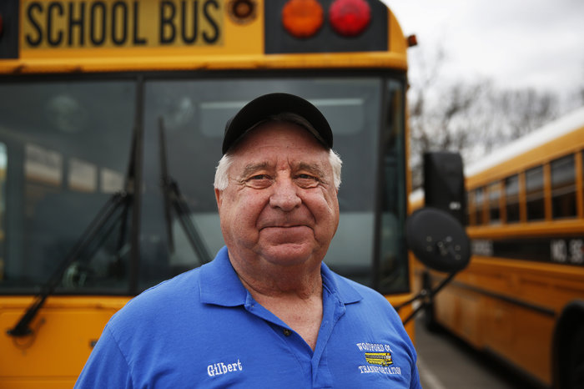
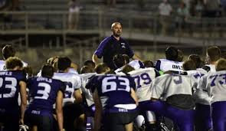
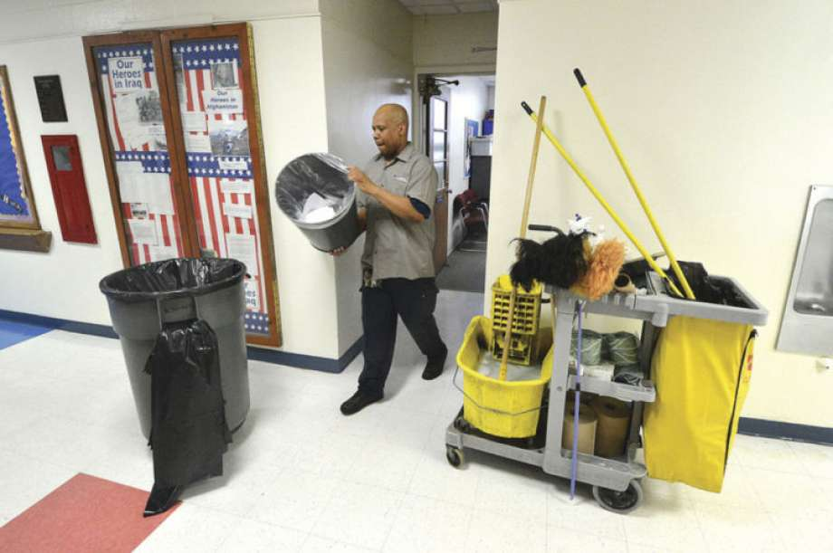

Slide 11
GFG and Financial Literacy
Assisting with education and navigation of life’s financial decisions

Slide 12
GFG and Financial Literacy
Study Hall
General Financial Literacy and TRS Education Campaign:
20-30 Minute Presentation at Each Campus
Education of TRS Retirement Benefits and Calculations
Introduction of the “Retirement Gap”
Saving for Retirement (403b, 457, IRA, etc.)
Making the Most of Your Income
Notes:
We can either ignore the responsibility we have as leaders and push each employee to seek out financial literacy on their own. Or we identify key markers and shine light on what our employees need to be thinking about as they prepare for their future. So what do we do? Pretty simple really, we:
Lead by setting markers (not to different than we do for attendance and academic rigor)
- starting with community effects – and how healthy a local economy can be if its largest employer (likely you) is retiring out healthy citizens (tax revenues, spending, housing price stability that leads to higher tax revenues for the ISD etc. etc.)
We put a specific target out there to double participation in retirement plans (national avg is 21% in K12 versus closer to 80% in corporate world 401ks)
Second:
We provide information that’s relevant to our employees. Things that matter to them. Not generic stuff. But stuff that centers around TRS, Social Security, Planning for Secondary Education, eliminating debt and of course retirement planning
And last but not least, we need to meet people where they’re at. And that means being available onsite consistently for one on one questions. And it also means providing the ability to enroll in your group plans online, in the middle of night any day of the year. Not just once or twice a year when an enrollment window comes around.
With a clear upgrade in targets, relevance and accessibility each ISD will see an impact, but to help employees reach their full potential, we need the one ingredient that has been missing in our space from the beginning. It’s the magic ingredient that Gentry has been know for for decades. And it’s the key to any kind of success.

Slide 13
GFG and Financial Literacy
Retiring Soon
In-Depth Retirement Review for Those Within 5 Years of Retiring:
45-60 Minute Presentation for Entire District
TRS Retirement Deep Dive
Calculating Benefits
Survivorship and Partial Lump-Sum Options
Social Security and TRS Correlation
TRS-Care Benefits and Medicare
Retirement Checklist and How to File
Notes:
We can either ignore the responsibility we have as leaders and push each employee to seek out financial literacy on their own. Or we identify key markers and shine light on what our employees need to be thinking about as they prepare for their future. So what do we do? Pretty simple really, we:
Lead by setting markers (not to different than we do for attendance and academic rigor)
- starting with community effects – and how healthy a local economy can be if its largest employer (likely you) is retiring out healthy citizens (tax revenues, spending, housing price stability that leads to higher tax revenues for the ISD etc. etc.)
We put a specific target out there to double participation in retirement plans (national avg is 21% in K12 versus closer to 80% in corporate world 401ks)
Second:
We provide information that’s relevant to our employees. Things that matter to them. Not generic stuff. But stuff that centers around TRS, Social Security, Planning for Secondary Education, eliminating debt and of course retirement planning
And last but not least, we need to meet people where they’re at. And that means being available onsite consistently for one on one questions. And it also means providing the ability to enroll in your group plans online, in the middle of night any day of the year. Not just once or twice a year when an enrollment window comes around.
With a clear upgrade in targets, relevance and accessibility each ISD will see an impact, but to help employees reach their full potential, we need the one ingredient that has been missing in our space from the beginning. It’s the magic ingredient that Gentry has been know for for decades. And it’s the key to any kind of success.

Slide 14
GFG and Financial Literacy
Matching Plans
Benefits of Offering a Matching Plan
Competition / Talent
Retention
FICA Alternative
Healthy Culture
Retractable / Flexible
Individual Impact
Community Impact
$100/mo contributions at 7%
Participation from 3% - 8% up to 37% - 45%
Notes:
We can either ignore the responsibility we have as leaders and push each employee to seek out financial literacy on their own. Or we identify key markers and shine light on what our employees need to be thinking about as they prepare for their future. So what do we do? Pretty simple really, we:
Lead by setting markers (not to different than we do for attendance and academic rigor)
- starting with community effects – and how healthy a local economy can be if its largest employer (likely you) is retiring out healthy citizens (tax revenues, spending, housing price stability that leads to higher tax revenues for the ISD etc. etc.)
We put a specific target out there to double participation in retirement plans (national avg is 21% in K12 versus closer to 80% in corporate world 401ks)
Second:
We provide information that’s relevant to our employees. Things that matter to them. Not generic stuff. But stuff that centers around TRS, Social Security, Planning for Secondary Education, eliminating debt and of course retirement planning
And last but not least, we need to meet people where they’re at. And that means being available onsite consistently for one on one questions. And it also means providing the ability to enroll in your group plans online, in the middle of night any day of the year. Not just once or twice a year when an enrollment window comes around.
With a clear upgrade in targets, relevance and accessibility each ISD will see an impact, but to help employees reach their full potential, we need the one ingredient that has been missing in our space from the beginning. It’s the magic ingredient that Gentry has been know for for decades. And it’s the key to any kind of success.

Slide 15
GFG and Financial Literacy
Matching Plans
Gentry Financial Group’s Role
Structure, Organization, and Presentation of Plan
Individualized to the District’s Budget and Goals
Dollar-for-Dollar Match
% of Salary Matched Based Off Tiered, Tenure-Based Approach
Vesting Schedule
TPA Partnership to Oversee Compliance with IRS Regulations
Notes:
We can either ignore the responsibility we have as leaders and push each employee to seek out financial literacy on their own. Or we identify key markers and shine light on what our employees need to be thinking about as they prepare for their future. So what do we do? Pretty simple really, we:
Lead by setting markers (not to different than we do for attendance and academic rigor)
- starting with community effects – and how healthy a local economy can be if its largest employer (likely you) is retiring out healthy citizens (tax revenues, spending, housing price stability that leads to higher tax revenues for the ISD etc. etc.)
We put a specific target out there to double participation in retirement plans (national avg is 21% in K12 versus closer to 80% in corporate world 401ks)
Second:
We provide information that’s relevant to our employees. Things that matter to them. Not generic stuff. But stuff that centers around TRS, Social Security, Planning for Secondary Education, eliminating debt and of course retirement planning
And last but not least, we need to meet people where they’re at. And that means being available onsite consistently for one on one questions. And it also means providing the ability to enroll in your group plans online, in the middle of night any day of the year. Not just once or twice a year when an enrollment window comes around.
With a clear upgrade in targets, relevance and accessibility each ISD will see an impact, but to help employees reach their full potential, we need the one ingredient that has been missing in our space from the beginning. It’s the magic ingredient that Gentry has been know for for decades. And it’s the key to any kind of success.

Slide 16
Co-Op Benefit Updates

Slide 17
New products with Guardian for 2023
Vision
Accident
Hospital Indemnity
High-Level Overview:
Matched plan design with Davis Network – formerly owned by Versant (as was Superior).
Davis Full Feature
(includes Warby Parker)
3-year Rate Guarantee
High-Level Overview:
Enriched plan design for higher claim payouts with $150 wellness
Enriched plan design
$150 wellness
3-year Rate Guarantee
High-Level Overview:
Matching inforce design with enhancements on ICU
$2,500 admission benefit
100/200 confinement
$50 wellness
No pre-ex or maternity limitation
3-year Rate Guarantee
Tier | Monthly Rate
EE | $ 8.98
EE+SP (EE+1) | $ 15.28
EE+CH | $ 16.16
EE+FAM (EE>1) | $ 24.26
Tier | Monthly Rate
EE | $ 13.52
EE+SP (EE+1) | $ 21.58
EE+CH | $ 26.78
EE+FAM (EE>1) | $ 41.86
Tier | Monthly Rate
EE | $ 19.28
EE+SP (EE+1) | $ 33.00
EE+CH | $ 26.54
EE+FAM (EE>1) | $ 47.74

Slide 18
Communication
Informational Email
How to utilize current benefits
Info on benefits you may not be taking advantage of
Example: Disability & Hospital Indemnity

Slide 19
Communication
How can Disability/Hospital Indemnity help?
Disability Benefit: $3,300 – $44/mo
Hospital In. Benefit: $2,500 – $19/mo
Annual Premium - $756
Total Benefit Payout - $5,800

Slide 20
Telemedicine Employer-Paid Benefit
25 of 65 Districts Participating
Avg cost of doctor’s visit is close to $300
4,000 Gentry Group calls since 9/1/22 for a potential savings of $600,000
District Cost: $7.25 PEPM

Slide 22
Enrollment Strategy 2023
How to complete an efficient and effective open-enrollment!
This Photo by Unknown Author is licensed under CC BY-NC-ND

Slide 23
Proven Benefits of Employee Driven Enrollment
Can enroll at own pace
24/7 enrollment access
Employees VISUALIZE their benefit package
Extended dialogue with spouse helps better decision making
More ownership for employees and less liability for district

Slide 24
The Communication Conundrum
20% of employees say they don't keep up with benefits correspondence (e.g., they don't attend company benefits meetings, don't read their summary plan descriptions or they file/throw benefits materials away unread). (SHRM)
Employees can ignore about 40% of e-mails (HR Daily Advisor)

Slide 25
Tips for Successful Open Enrollment
Communicate Early
Start Announcing Open Enrollment Ahead of Start Date (mid June)
Communicate Often
Send weekly reminders once open enrollment begins (include time left to enroll in each reminder)
Be Precise on Setting Open Enrollment Dates
More than one-half (52%) of organizations have an open enrollment period that lasts two weeks. Three- (24%) and four-week (17%) open enrollment periods are also common.
Shorter enrollment window creates emphasis
Leverage Technology
When employees do their own benefits administration online, it results in a 15% time savings by HR staff.
Track Progress and use Email Reminder in The Hub
High completion rates equals less problems!
This Photo by Unknown Author is licensed under CC BY-NC-ND

Slide 26
Benefit Communication with GFG
Direct Employees to the Benefits Website
Show off your Benefits Guide
Use Email Announcement prepared by GFG
Office Support
Phone assisted enrollment
Bilingual
10 Full-time GFG employees
Summer Zoom Meetings
On Site Presentations
This Photo by Unknown Author is licensed under CC BY-SA-NC

Slide 27
For districts wanting to add TRS Active-Care to the HUB, you will need to submit the Transfer Notification to bswift by May 1
Schedule any meetings or presentations with GFG.

Slide 28
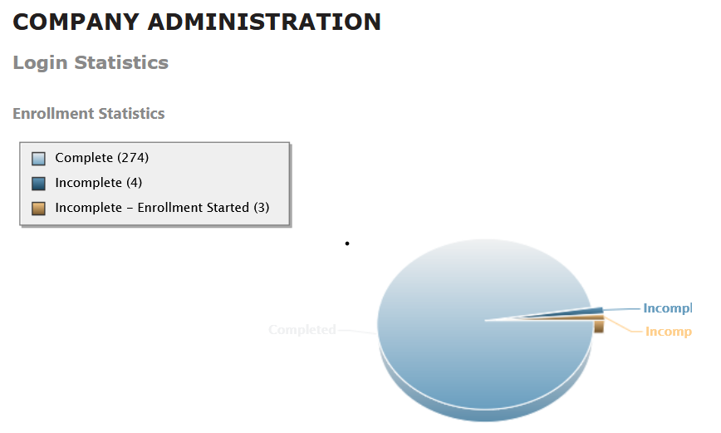
Bonus Slide
2023 GFG District Incentive Plan
Any benefit manager that achieves 90% or higher enrollment completion at their school will receive lunch for their administration office.
Plus, a $25 Amazon Gift Card!

Slide 29
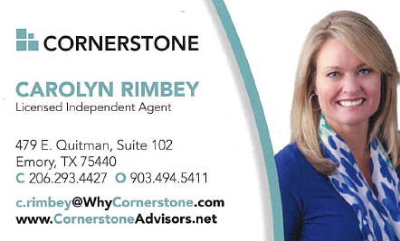
Employee assistance with Medicare transitions

Slide 30
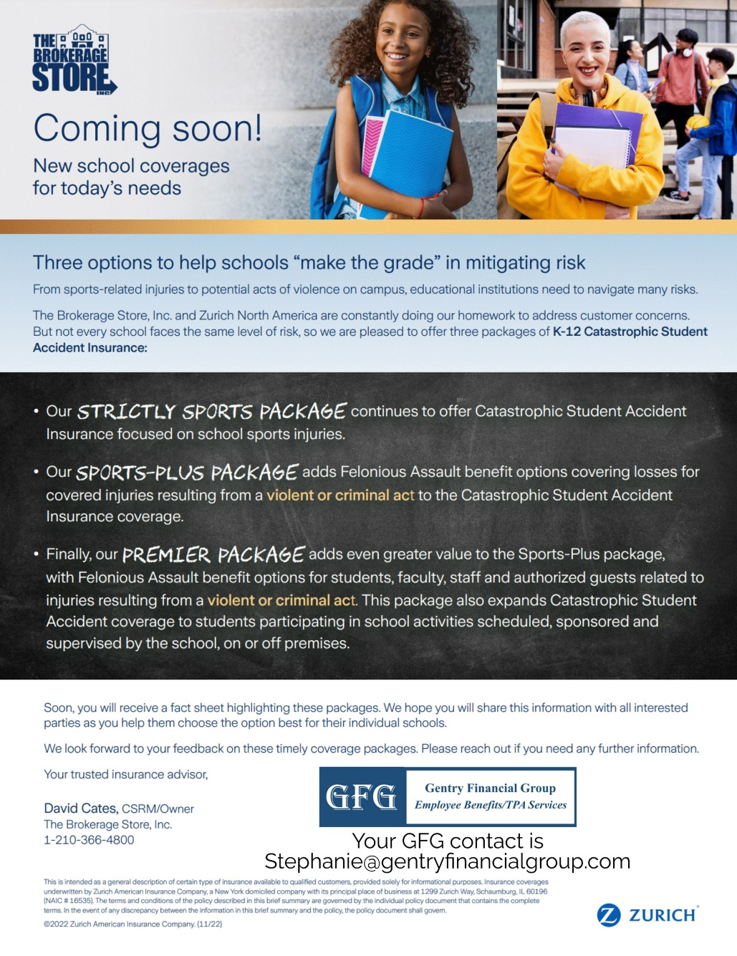
? Did you know, GFG offers Student Accident Coverage

